Slide 1
CHANGING THE GAME IN
ADOLESCENT-CENTERED DESIGN:
ASSETS, ACCESS, ADHERENCE
#changingthegame #AIDS2108
Please tag @grassrootsoccer

Slide 2
UNAIDS World AIDS Day 2017 Report: Blind Spot
Reaching out to men and boys — Addressing a blind spot in the response to HIV
58% of AIDS-related deaths globally are amongst men
Gap is greatest in sub-Saharan Africa - men and boys account for 41% of people living with HIV and yet made up 53% of AIDS-related deaths
Men and boys lag behind women and girls across all three 90s
Uptake of male prevention services such as condoms and VMMC is slowing
Identified lack of male-friendly services and harmful gender norms as two key drivers of the gender gap
Triple dividend when men and boys access prevention and treatment services: they protect themselves, their sexual partners and their families

Slide 3
Key Data and Statistics
Globally less than half of men living with HIV are on treatment, compared to 60% of women
In sub-Saharan Africa, men and boys living with HIV are 20% less likely than women and girls living with HIV to know their HIV status, and 27% less likely to be accessing treatment.
In western and central Africa only 25% of men living with HIV are accessing treatment – the lowest of any region globally
One study in South Africa showed that 70% of men who had died from AIDS-related illnesses had never sought care for HIV
Men who have sex with men are 24 times more likely to acquire HIV than men in the general population.

Slide 4
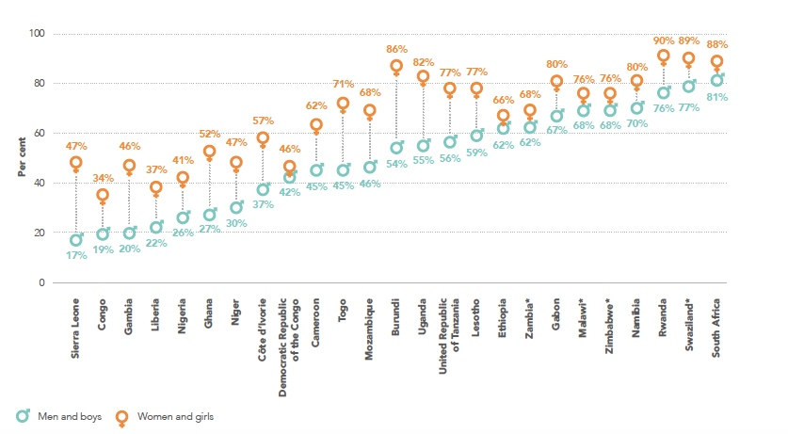
Progress Against the First 90 in Sub-Saharan Africa by Sex

Slide 5
Illustrative Regional Progress against 90-90-90 Cascade

Slide 6
Progress is needed along two intertwined paths
Expand male-friendly health services to improve uptake and adherence
Engaging men in testing is the first step to them taking responsibility about HIV
Providing services that suit the needs and lifestyles of men is key
Invest in gender-transformative programs and a supportive policy environment
Introducing purposeful policies and practices that remove gender inequalities and promote more equitable gender norms and institutional arrangements will benefit both women and men
Expanding boys and girls programs early in life that challenge gender norms, toxic masculinity, and male stereotypes can help break the cycle

Slide 7
CHANGING THE GAME IN
ADOLESCENT-CENTERED DESIGN:
ASSETS, ACCESS, ADHERENCE
#changingthegame #AIDS2108
Please tag @grassrootsoccer

